Slide 1
BSCS-7th Semester
M. Arham
Lecturer
The University of Faisalabad

Slide 2
Compiler Construction
Course Code: CS-411
Lecture 03

Slide 3




www.tuf.edu.pk
unioffaisalabad
Credit Hours: 3(3-0)
Theory: Cr. Hr. 03
Practical: Cr. Hr. 00

Slide 4
Content
Lexical Analysis (LA) Will discussed inWeek 2 lecture 5
Syntax Analysis (SA) Will discussed in Week 3 lecture 9
Intermediate Code Generation (ICG)
Code Generation
Code Optimization

Slide 5
Lexical Analysis (LA)
1st phase of compiler
Part of front end of compiler
Reads the source program as a file of characters and divide them up into tokens
Tokens are recognized using Finite Automata or Transition Diagrams

Slide 6
Lexical Analysis (LA)
The vital functions of Lexical Analyzer are:
  Seprate tokens from program
  Insert tokens into symbol table
  Eliminates whitespaces, comments, newline characters, etc... from string.
  Give tokens to parser (pass their integer no./code to parser)
  Keep track of line numbers (for error handling)
  Pre-processing of Macros

Slide 7
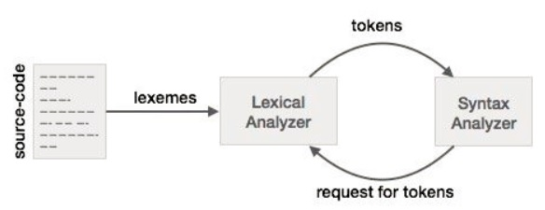
Lexical Analysis (LA)
Notes:
Lexeme is a sequence of characters in the source program that matches the pattern for a token and is identified by the lexical analyzer as an instance of that token.

Slide 8
Syntax Analysis (SA)
Syntax Analysis is a second phase of the compiler design process after Laxical analysis in which the given input string is checked for the confirmation of rules and structure of the formal grammer.
Syntax analyzer or Parser analyses the syntactical structure and checks if the given input is in the correct syntax of the programming language or not.
It does so by getting the input from the tokens and building a data structure, called a syntax tree or parse tree.

Slide 9
Syntax Analysis (SA)

Slide 10
Intermediate Code Generation (ICG)
During the translation of a source program into object code for a target machine, a compiler May generate a middle-level language code, which is known as intermediate code.

Slide 11
Intermediate Code Generation (ICG)
Translates source → Intermediate Representation (IR
Example:
Expression: a + b * c
t1 = b * c
t2 = a + t1

Slide 12
Code Generation
Converts IR → Target Machine Code
Responsible for:
  Instruction selection
  Register allocation
  Handling addressing modes
Role of Code Generator
  Input: Intermediate Representation (IR)
  Output: Assembly / Machine Code
Goals:
  Correctness (faithful translation)
  Efficiency (optimized for speed/size)
  Maintainability (readable assembly when needed)

Slide 13
Code Generation
Challenges in Code Generation
Limited number of registers
Instruction set variations across hardware
Memory management
Trade-off between speed & size
Handling complex control structures (loops, branches)

Slide 14
Code Generation
Example of Code Generation
Expression: a + b * c
Intermediate Code (IR):
  t1 = b * c
  t2 = a + t1
Target Code (Assembly):
  MOV R1, b
  MUL R1, c
  ADD R1, a

Slide 15
Code Optimization
Process of improving intermediate or machine code
Goal: Make code faster, smaller, and more efficient
Must not change program meaning
Goals of Code Optimization
  Reduce execution time (speed)
  Reduce memory usage (space)
  Improve power efficiency
  Maintain correctness of the program

Slide 16
Code Optimization
Types of Code Optimization
Machine-Independent Optimization
  Works on Intermediate Representation (IR)
  Example: Dead code elimination, loop optimizations
Machine-Dependent Optimization
  Based on target architecture
  Example: Register allocation, instruction scheduling

Slide 17
Code Optimization
Example of Optimization
Expression:
x = (a * b) + (a * b)
Before Optimization (IR):
  t1 = a * b
  t2 = a * b
  x = t1 + t2
After Optimization (CSE):
  t1 = a * b
  x = t1 + t1

Slide 18
Code Optimization
Benefits of Code Optimization
Faster execution
Smaller executable size
Reduced resource usage
Better user experience

Slide 19
www.tuf.edu.pk
unioffaisalabad
Advice…!!
Kindly read the book before and after the lecture, if some terms/ words are not covered in the lecture, if appear in exam it might not appear strange or out of course.

